Slide 1
Statistical Analysis- ST1002
The Normal Distribution

Slide 2
Learning Objectives
In this section, you will learn:
To compute probabilities from the normal distribution
To use the normal probability plot to determine whether a set of data is approximately normally distributed

Slide 3
Dover sole
A sample of 300 fish
Mean= 1.5 kgs
SD = 0.44kgs

Slide 4
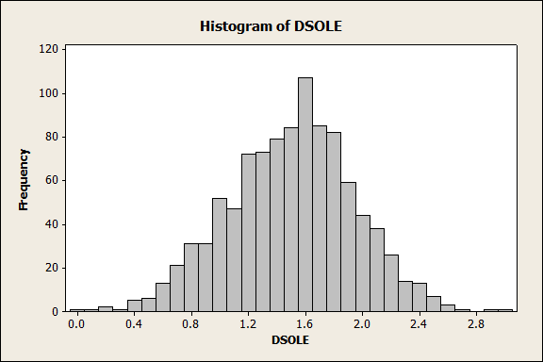
Weights of Dover Sole

Slide 5
Have a quick look and then forget ..

Slide 6
What is so special about the Normal Distribution?
Lots of variables have this shape
Appears in Statistical theory quite a lot
We can say lots about a variable with this type of distribution provided we know the mean and SD.
50% of obs ≤ mean
50% of obs ≥ mean

Slide 7
The Normal Distribution
‘Bell Shaped’
Symmetrical
Mean, Median and Mode
are Equal
Location is determined by the mean, μ
Spread is determined by the standard deviation, σ
The variable has an infinite theoretical range:
+ ∞ to − ∞
σ
X
μ
Mean
= Median
= Mode

Slide 8
Many Normal Distributions
By varying the parameters μ and σ, we obtain different normal distributions

Slide 9
And more statements....
68% of obs. fall between Mean ± 1 SD
2.5% are ≥ Mean + 1.96* SD
5% are less ≤ Mean – 1.64*SD
Approx all of the data fall within mean ± 3 SD
We can make lots more of these types of statements

Slide 10
In terms of weight....
Mean = 1.5 kgs and the SD = 0.44 kgs
68% of fish weigh between 1.5 ± 0.44 kgs
1.06 kgs to 1.94 kgs
2.5% of fish more than 1.5+1.96*0.44kgs=2.36 kgs
Approx maximum size of fish =
1.5 +3*0.44=2.82 kgs

Slide 11
The Standardized Normal Distribution
Also known as the “Z” distribution
Mean is 0
Standard Deviation is 1
1
Z
0
Values above the mean have positive Z-values, values below the mean have negative Z-values

Slide 12
The Standardized Normal
Any normal distribution (with any mean and standard deviation combination) can be transformed into the standardized normal distribution (Z)
Mean = 0 and SD = 1
Need to transform X units into Z units

Slide 13
Translation to the Standardized Normal Distribution
Translate from X to the standardized normal (the “Z” distribution) by subtracting the mean of X and dividing by its standard deviation:
The Z distribution always has mean = 0 and standard deviation = 1

Slide 14
Example
If X is distributed normally with mean of 100 and standard deviation of 50, the Z value for X = 200 is
This says that X = 200 is two standard deviations (2 increments of 50 units) above the mean of 100.

Slide 15
Table of figures
Only one table needed Mean = 0, SD =1
But many formats of this table available
Proportion/probability/percentage of area (cases) which are less than x where x is given by column and row headings
0.72
Look under 0.7 and 0.02

Slide 16
Looking up table
 | 0.0 | 0.01 | 0.02 | 0.03
0.0 | 0.50 | 0.50 | 0.51 | 0.51
0.1 | 0.54 | 0.54 | 0.55 | 0.55
0.2 | 0.58 | 0.58 | 0.59 | 0.59
0.3 | 0.62 | 0.62 | 0.63 | 0.63
0.4 | 0.66 | 0.66 | 0.66 | 0.67
0.5 | 0.69 | 0.69 | 0.70 | 0.70
0.6 | 0.73 | 0.73 | 0.73 | 0.74
0.7 | 0.76 | 0.76 | 0.76 | 0.77

Slide 17
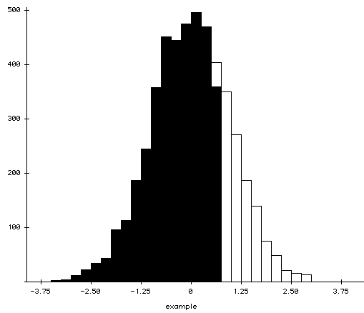
Graph
76% of observations are less then mean+0.72 SD

Slide 18
More examples
0.58
2.8
5.0
1.8
2.3
1.73

Slide 19
General Procedure for Finding Probabilities/proportions
To find P(a ≤ X ≤ b) when X is distributed normally:
Draw the normal curve for the problem in
terms of X
Translate X-values to Z-values
Use the Standardized Normal Table

Slide 20
Finding Normal Probabilities
Suppose X is normal with mean 8.0 and standard deviation 5.0
Find P(X ≤ 8.6)
X
8.0
8.6

Slide 21
Finding Normal Probabilities
Suppose X is normal with mean 8.0 and standard deviation 5.0. Find P(X ≤ 8.6)
μ = 8
σ = 5
μ = 0
σ = 1
8
8.6
X
0
0.12
Z
P(X ≤ 8.6)
P(Z ≤ 0.12)

Slide 22
Solution: Finding P(Z ≤ 0.12)
Standardized Normal Probability
Table (Portion)
P(X ≤ 8.6)
= P(Z ≤ 0.12)
0.55
 | 0.0 | 0.01 | 0.02
0.0 | 0.50 | 0.50 | 0.51
0.1 | 0.54 | 0.54 | 0.55
0.2 | 0.58 | 0.58 | 0.59
Z
0.00
0.12

Slide 23
Upper Tail Probabilities
Suppose X is normal with mean 8.0 and standard deviation 5.0.
Now Find P(X ≥ 8.6)
X
8.0
8.6

Slide 24
Upper Tail Probabilities
Now Find P(X > 8.6)…
P(X ≥ 8.6) = P(Z ≥ 0.12) = 1.0 - P(Z ≤ 0.12)
= 1.0 - 0.55 = 0.45
0.55
1.000
1.0 - 0.55 = 0.45
Z
Z
0
0
0.12
0.12

Slide 25
Probability Between Two Values
Suppose X is normal with mean 8.0 and standard deviation 5.0. Find P(8 ≤ X ≤ 8.6)
Calculate Z-values:
8
8.6
X
0
0.12
Z
P(8 ≤ X ≤ 8.6)
= P(0 ≤ Z ≤ 0.12)

Slide 26
Solution: Finding P(0 ≤ Z ≤ 0.12)
P(8 ≤ X ≤ 8.6)
Standardized Normal Probability
Table (Portion)
= P(0 ≤ Z ≤ 0.12)
= P(Z ≤ 0.12) – P(Z ≤ 0)
= 0.55 - 0.5000 = 0.05
 | 0.0 | 0.01 | 0.02
0.0 | 0.50 | 0.50 | 0.51
0.1 | 0.54 | 0.54 | 0.55
0.2 | 0.58 | 0.58 | 0.59
0.05
0.50
Z
0.00
0.12

Slide 27
Probabilities in the Lower Tail
Suppose X is normal with mean 8.0 and standard deviation 5.0.
Now Find P(7.4 ≤ X ≤ 8)
X
8.0
7.4

Slide 28
Probabilities in the Lower Tail
Now Find P(7.4 ≤ X ≤ 8)…
P(7.4≤X ≤ 8)
= P(-0.12 ≤ Z ≤ 0)
= P(Z ≤ 0) – P(Z ≤ -0.12)
P(Z ≤ -0.12)= P(Z≥0.12)=1-P(Z ≤ 0.12)
1-P(Z ≤ 0.12)= 1-0.55=0.45
P(Z ≤ 0) – P(Z ≤ -0.12)
= 0.50 - 0.45 = 0.05
0.05
0.45
7.4
8.0
X
-0.12
0
Z

Slide 29
Finding the X value for a Known Probability
Steps to find the X value for a known probability:
1. Find the Z value for the known probability
2. Convert to X units using the formula:

Slide 30
Finding the X value for a Known Probability
Example:
Suppose X is normal with mean 8.0 and standard deviation 5.0.
Now find the X value so that only 20% of all values are below this X
0.20
?
8.0
X
?
0
Z

Slide 31
Finding the X value for a Known Probability
Values below 8 correspond to negative Z’s.
Table does not give values for –Z
20% to left of –Z = 20% to right of +Z
=80% to left of positive Z
Look up table to find value closest to 0.80
This turns out to be 0.84

Slide 32
Finding the X value
2. Convert to X units using the formula:
0.2000
3.80
8.0
X
-0.84
0
Z
So 20% of the values from a distribution with mean 8.0 and standard deviation 5.0 are less than 3.80

Slide 33
A few points about table
Table only gives value for +Z
Proportion ≥ Z = 1-Proportion ≤ Z
Proportion ≥ -Z = Proportion ≤ Z
Proportion ≤ -Z =Proportion ≥ Z
= 1-Proportion ≤ Z

Slide 34
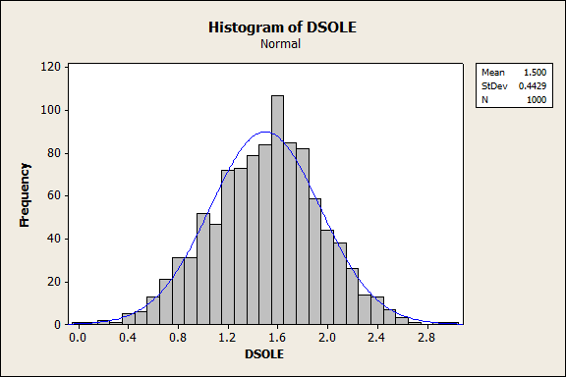
Histogram

Slide 35
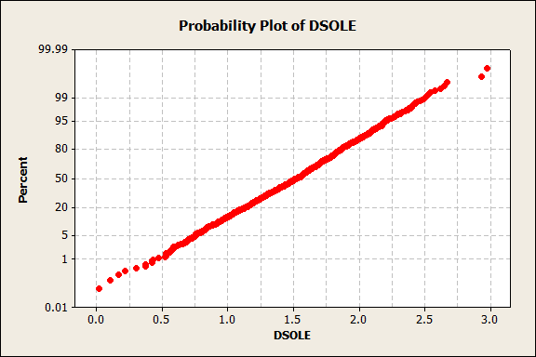
Normal probability plot
We are plotting our points on x – axis against ideal points from normal distribution on the y-axis

Slide 36
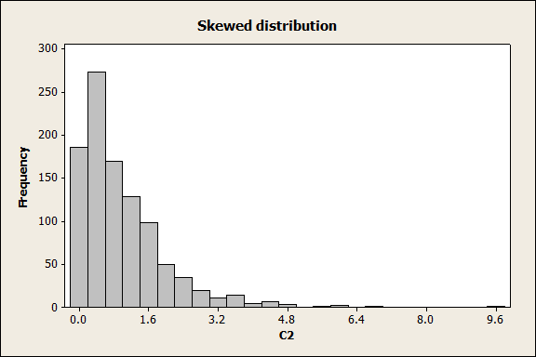
Another picture

Slide 37
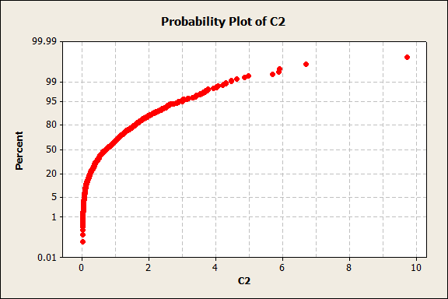
Normal Probability plot

Slide 38
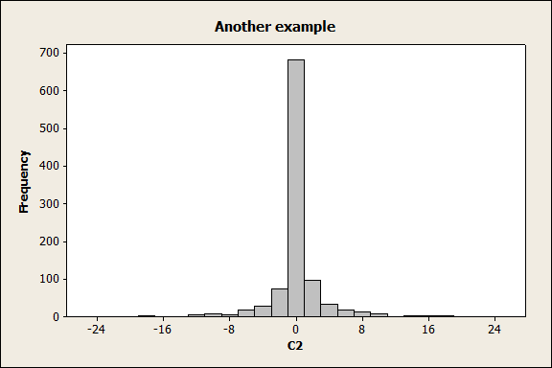
Another picture

Slide 39
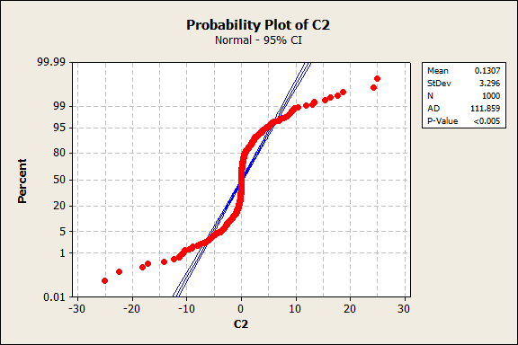
Normal probability

Slide 40
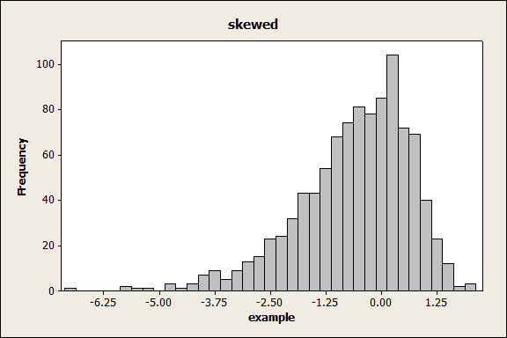
Another example

Slide 41
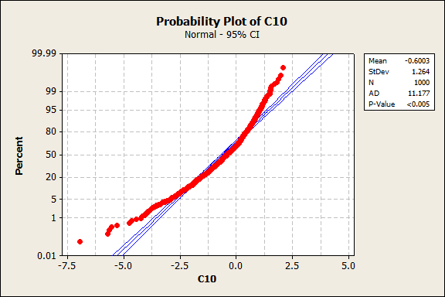
And probability plot

Slide 42
Summary
Lots of variables have a normal distribution
Many variables do not
Draw histograms
Very powerful information to know that is normal
Many other theoretical distributions
Poisson – Arthur
Exponential - Arthur

